Slide 1
Chapter 8 Failure
Ductile vs. brittle fracture
Principles of fracture mechanics
  Stress concentration
Impact fracture testing
Fatigue (cyclic stresses)
  Cyclic stresses, the S—N curve
  Crack initiation and propagation
  Factors that affect fatigue behavior
Creep (time dependent deformation)
  Stress and temperature effects
  Alloys for high-temperature use

Slide 2
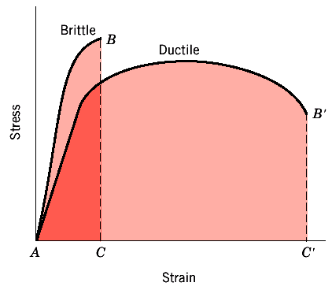
Brittle vs. Ductile Fracture
Ductile materials - extensive plastic deformation and energy absorption (“toughness”) before fracture
Brittle materials - little plastic deformation and low energy absorption before fracture
Ductile fracture
  Occurs with plastic deformation
Brittle fracture
  Little or no plastic deformation
  Catastrophic

Slide 3
Fracture
Steps : crack formation
crack propagation
Ductile - most metals (not too cold):
  Extensive plastic deformation before crack
  Crack “stable”: resists extension unless applied stress is increased
Brittle fracture - ceramics, ice, cold metals:
  Little plastic deformation
  Crack “unstable”: propagates rapidly without increase in applied stress

Slide 4
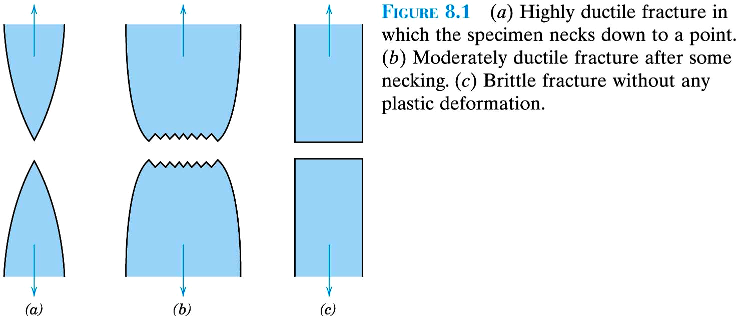
Very ductile: soft metals (e.g. Pb, Au) at room T, polymers, glasses at high T
Moderately ductile fracture
typical for metals
C. Brittle fracture: ceramics, cold metals,

Slide 5
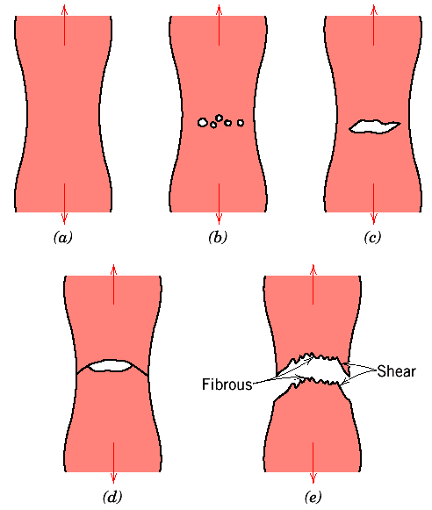
Ductile Fracture (Dislocation Mediated)
Crack grows 90º to applied stress
Necking
Cavity Formation
(c)Cavities coalesce
→ form crack
(d)Crack propagation
(e) Fracture
45^{O} - maximum shear stress

Slide 6
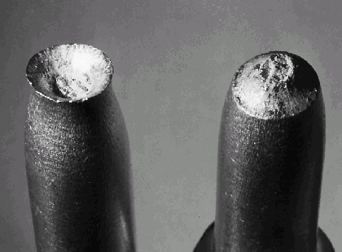
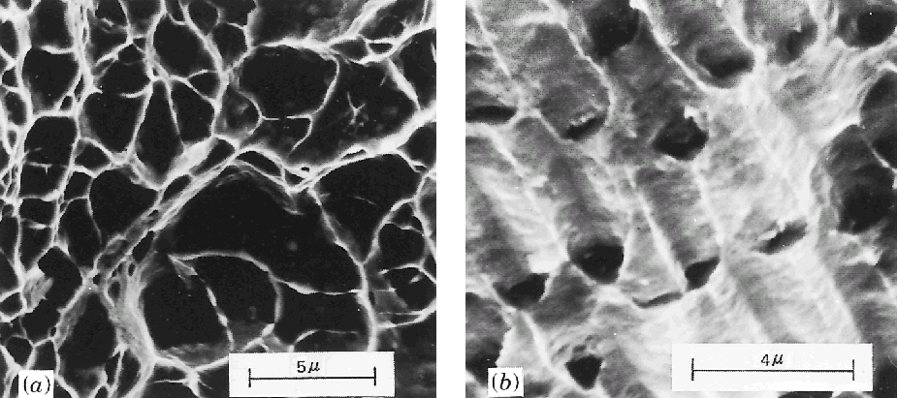
Ductile Fracture
(Cup-and-cone fracture in Al)
Scanning Electron Microscopy. Spherical “dimples” → micro-cavities that initiate crack formation.

Slide 7
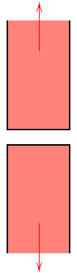
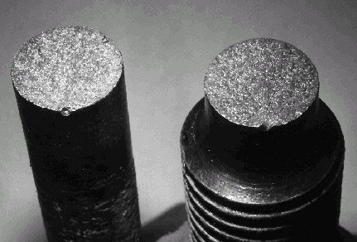
Brittle Fracture (Low Dislocation Mobility)
Crack propagation is fast
Propagates nearly perpendicular to direction of applied stress
Often propagates by cleavage - breaking of atomic bonds along specific crystallographic planes
No appreciable plastic deformation
Brittle fracture in a mild steel

Slide 8
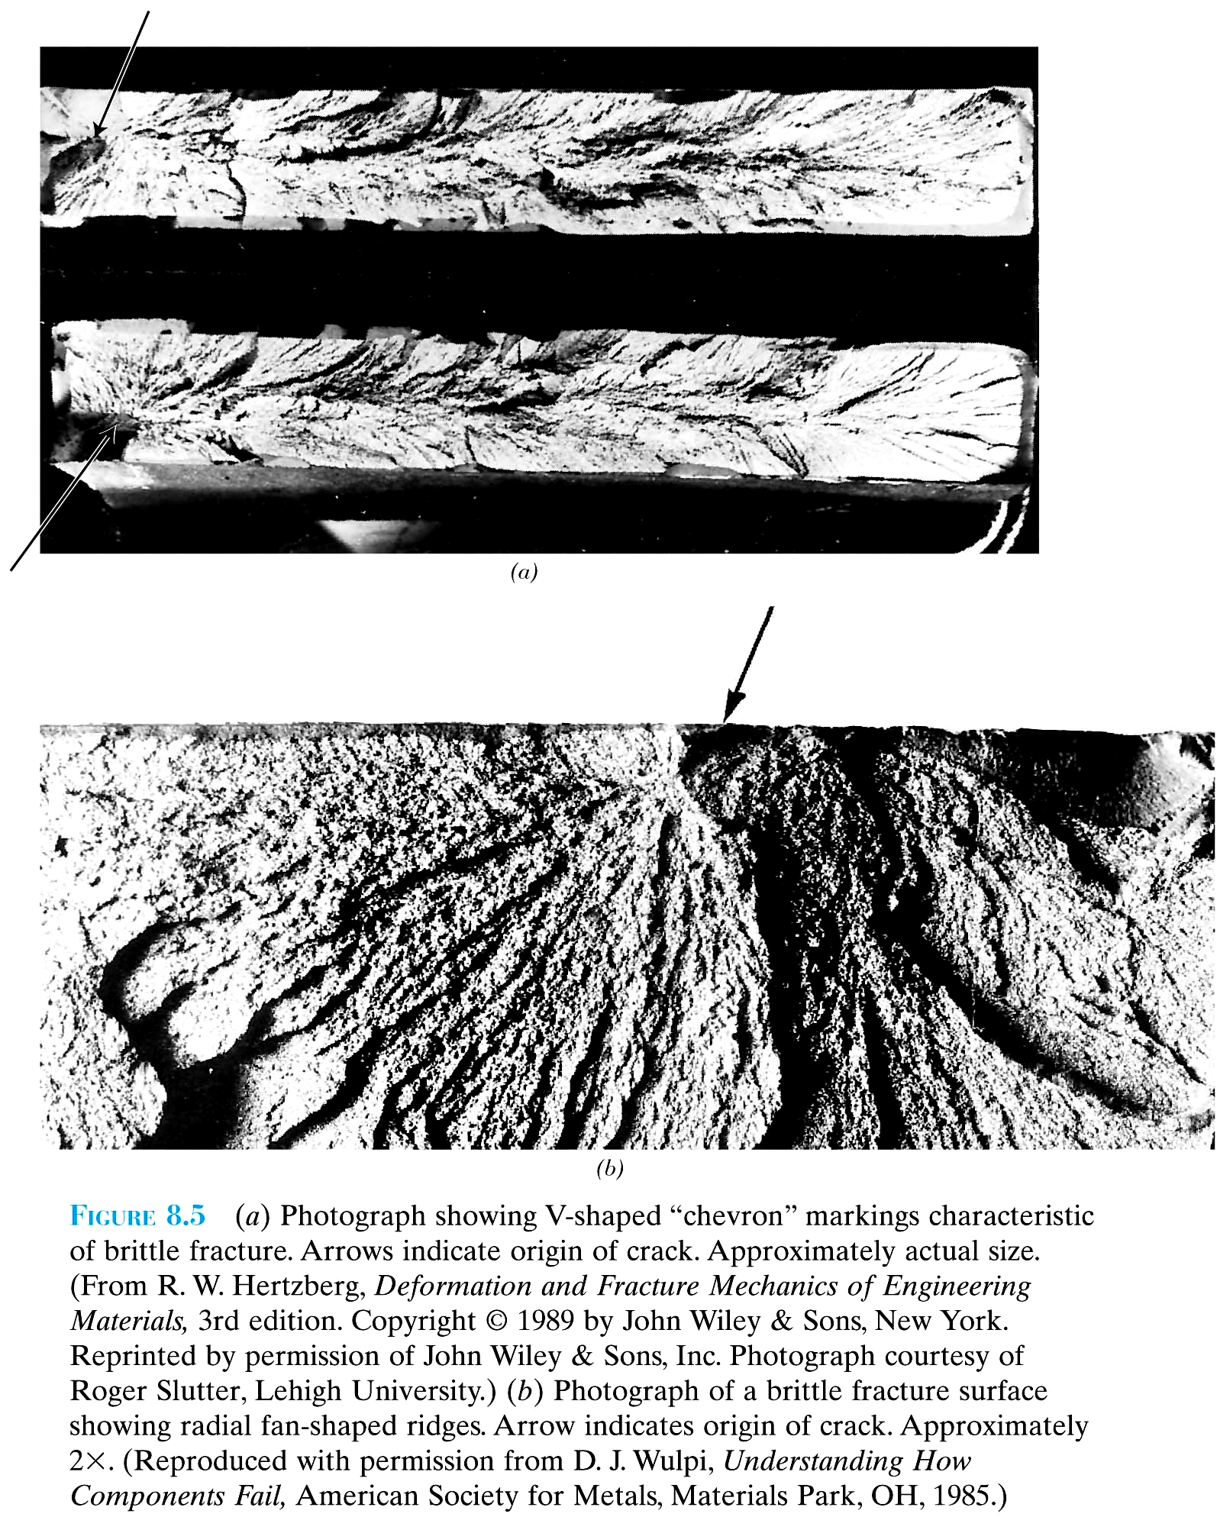

Slide 9
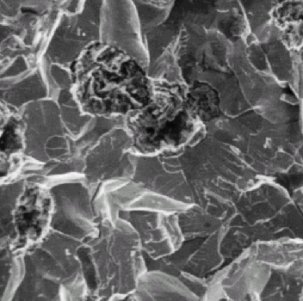
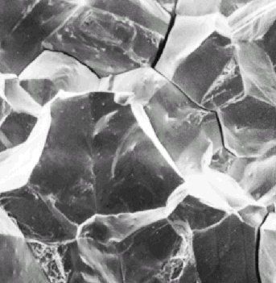
Transgranular fracture: Cracks pass through grains. Fracture surface: faceted texture because of different orientation of cleavage planes in grains.
Intergranular fracture: Crack propagation is along grain boundaries (grain boundaries are weakened/ embrittled by impurity segregation etc.)
A
B

Slide 10
Stress Concentration
Fracture strength of a brittle solid:
related to cohesive forces between atoms.
Theoretical strength: ~E/10
Experimental strength ~ E/100 - E/10,000
Lower fracture strength → stress concentration at microscopic flaws.
Stress amplified at tips of micro-cracks etc., called stress raisers.
Depends on orientation, geometry, dimensions.

Slide 11
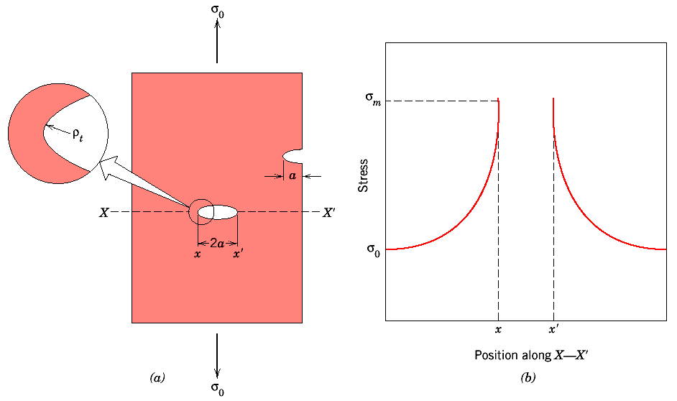

Slide 12
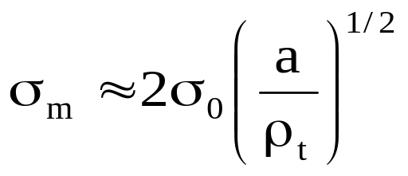
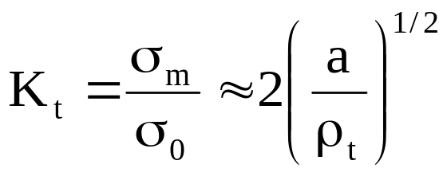
Crack perpendicular to applied stress:
maximum stress near crack tip →
σ₀ = applied stress; a = half-length of crack;
ρ_{t} = radius of curvature of crack tip.
Stress concentration factor→

Slide 13
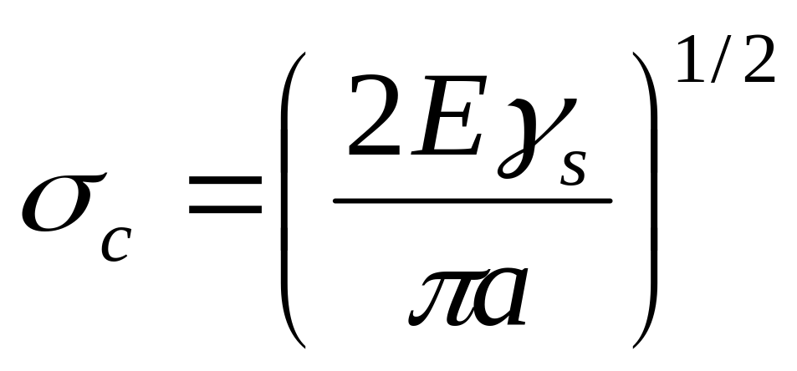
Critical stress required for crack propagation in a brittle materials
E=modulus of elasticity
γ_{s}=specific surface energy
a =one half the length of an internal crack

Slide 14
A relatively large plate of a glass is subjected to a tensile stress of 40 MPa. If the specific surface energy and modulus of elasticity for this glass are 0.3 J/m² and 69 GPa, respectively, determine the maximum length of a surface flaw that is possible without fracture.

Slide 15
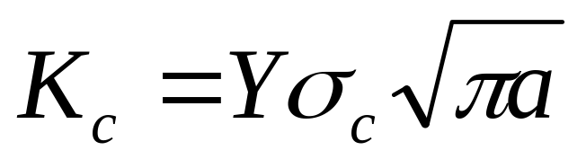
Fracture Toughness
Kc=fracture toughness
σ_{c}=critical stress for crack propagation
a =crack length
Y=dimensionless parameter or function that depends
on both crack and specimen size and gemetries, as
well as the manner of load application

Slide 16
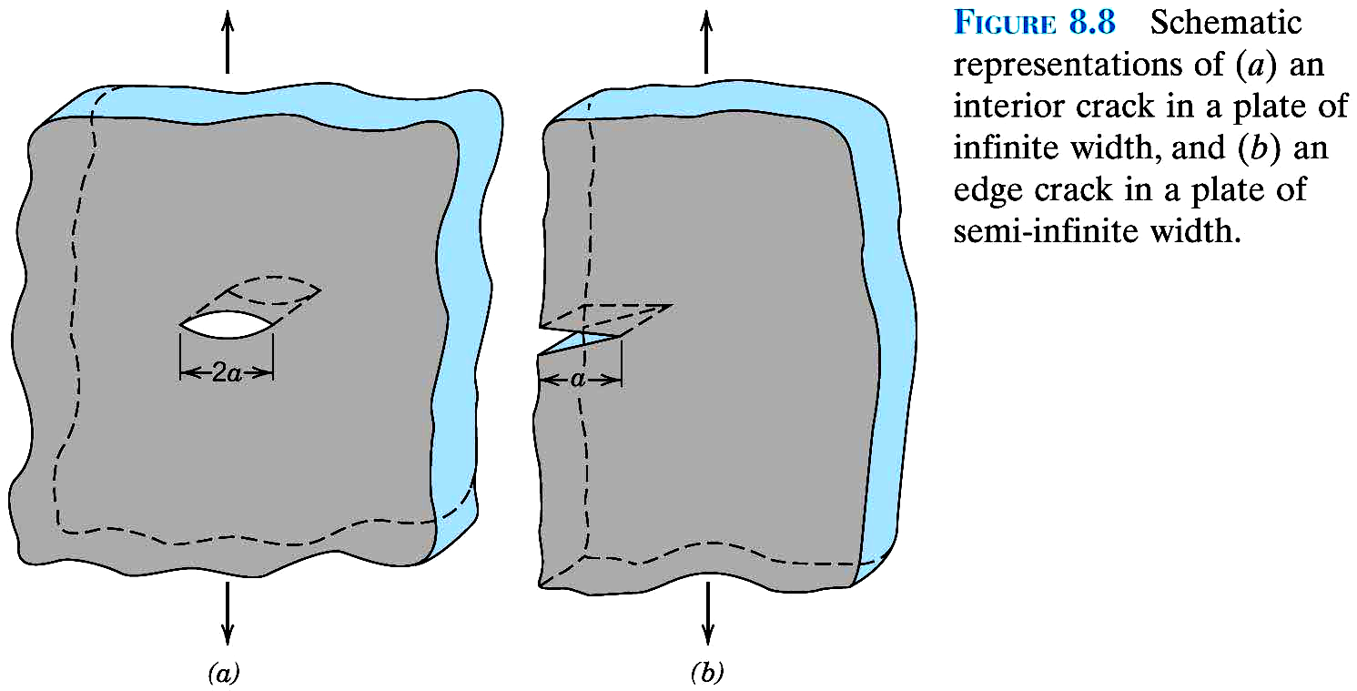
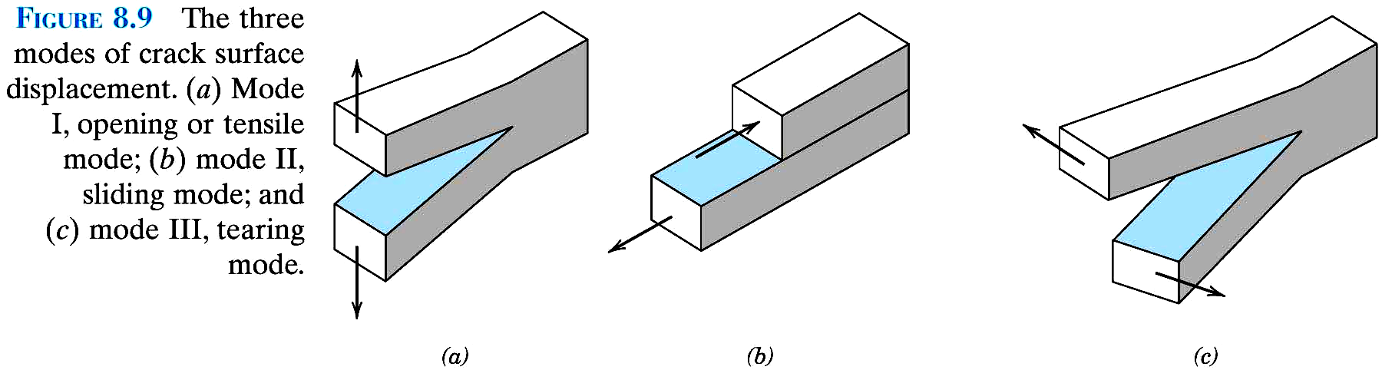

Slide 17
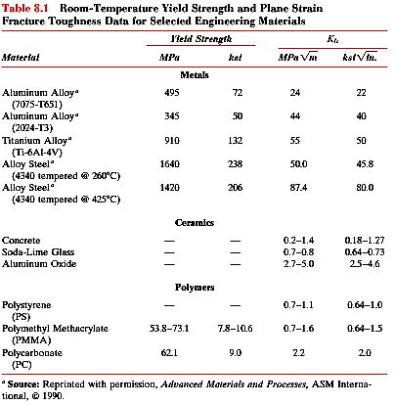

Slide 18
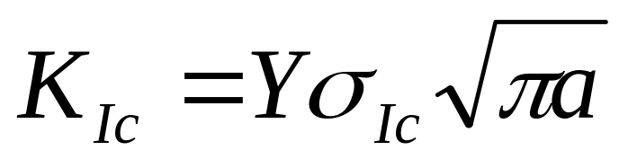
Plane Strain Fracture Toughness

Slide 19
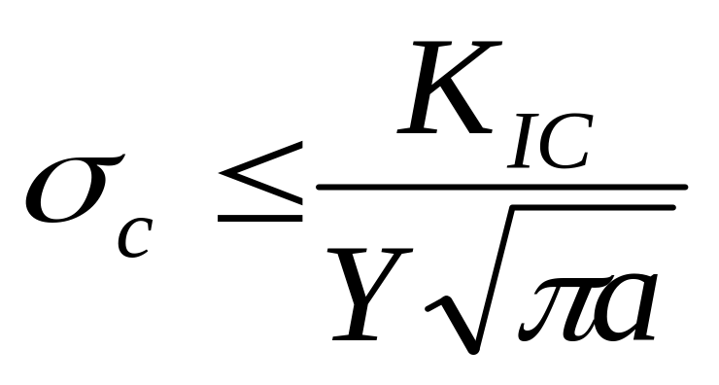
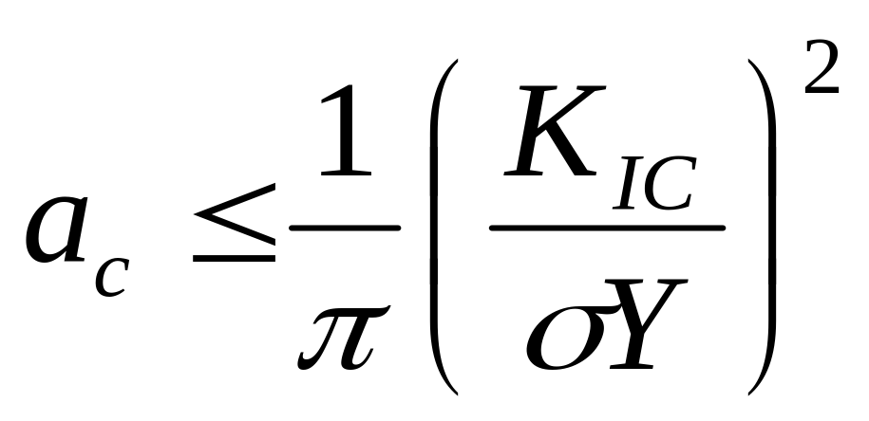
Critical Stress
Maximum allowable flaw size

Slide 20
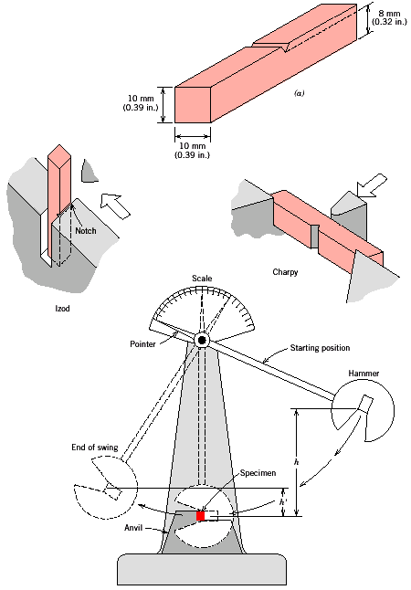
Impact Fracture Testing
testing fracture characteristics: high strain rates
Two standard tests: Charpy and Izod. Measure the impact energy (energy required to fracture a test piece under an impact load), also called the notch toughness.
Izod
Charpy
h
h’
Energy ~ h - h’

Slide 21
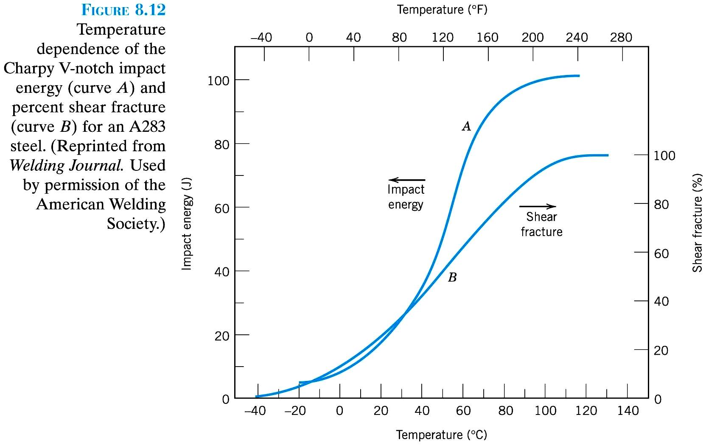
Ductile-to-Brittle Transition
As temperature decreases a ductile material can become brittle

Slide 22
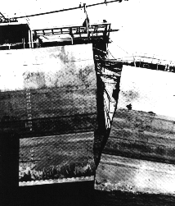
Ductile-to-brittle transition
Low temperatures can severely embrittle steels. The Liberty ships, produced in great numbers during the WWII were the first all-welded ships. A significant number of ships failed by catastrophic fracture. Fatigue cracks nucleated at the corners of square hatches and propagated rapidly by brittle fracture.

Slide 23
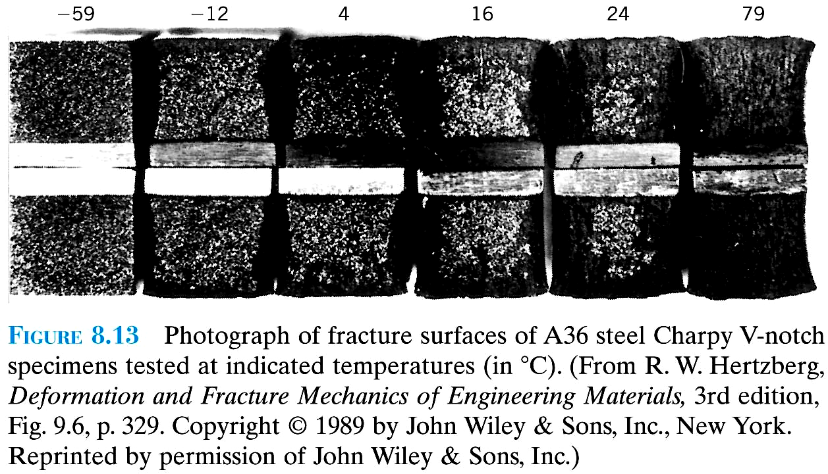

Slide 24
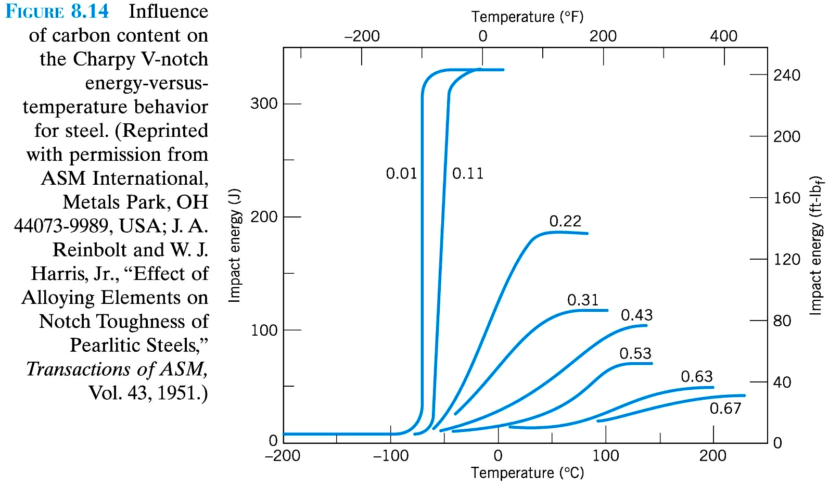

Slide 25
Fatigue
Failure under fluctuating stress
Under fluctuating / cyclic stresses, failure can occur at considerably lower loads than tensile or yield strengths of material under a static load.
Causes 90% of all failures of metallic structures (bridges, aircraft, machine components, etc.)
Fatigue failure is brittle-like (relatively little plastic deformation) - even in normally ductile materials. Thus sudden and catastrophic!
Fatigue failure has three stages:
crack initiation in areas of stress concentration
(near stress raisers)
incremental crack propagation
catastrophic failure

Slide 26
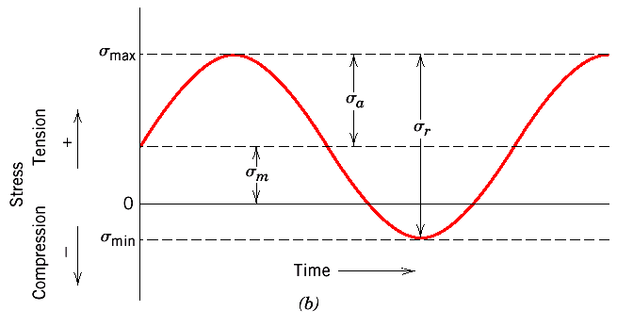
Fatigue: Cyclic Stresses
Cyclic stresses characterized by maximum, minimum and mean stress, the range of stress, the stress amplitude, and the stress ratio
Mean stress σ_{m} = (σ_{max} + σ_{min}) / 2
Range of stress σ_{r} = (σ_{max} - σ_{min})
Stress amplitude σ_{a} = σ_{r}/2 = (σ_{max} - σ_{min}) / 2
Stress ratio R = σ_{min} / σ_{max}
Convention:
tensile stresses → positive
compressive stresses → negative

Slide 27
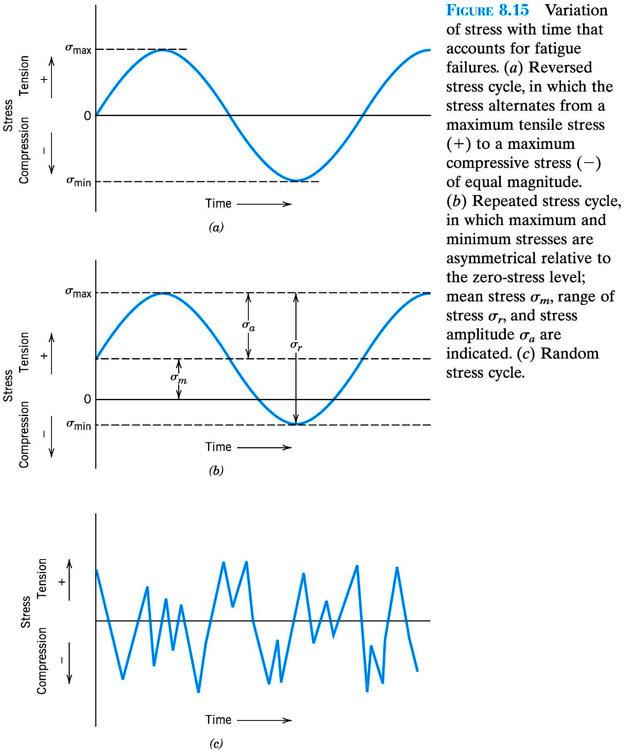

Slide 28
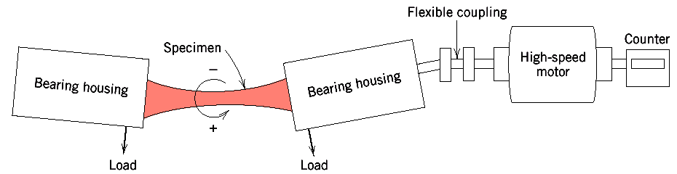
Rotating-bending test → S-N curves
S (stress) vs. N (number of cycles to failure)
Low cycle fatigue
high loads, plastic and elastic deformation
High cycle fatigue
low loads, elastic deformation (N > 10⁵)

Slide 29
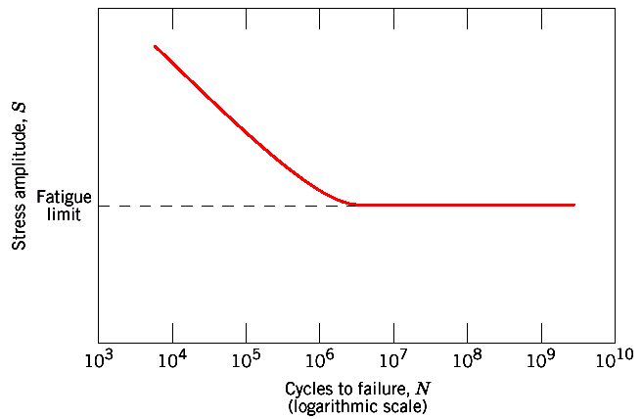
Fatigue: S—N curves
Fatigue limit (some Fe and Ti alloys)
S—N curve becomes horizontal at large N
Stress amplitude below which the material never fails, no matter how large the number of cycles is

Slide 30
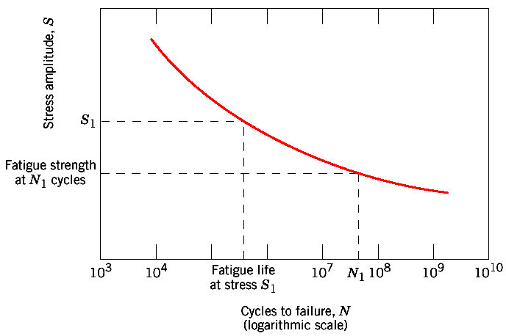
Most alloys: S decreases with N.
Fatigue strength: stress at which fracture occurs after specified number of cycles (e.g. 10⁷)
Fatigue life: Number of cycles to fail at specified stress level

Slide 31
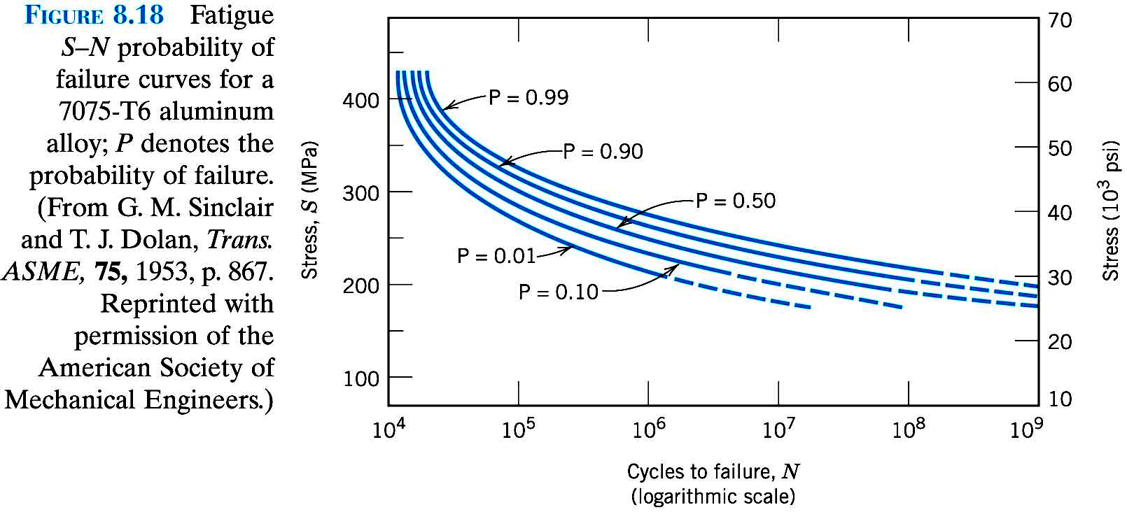

Slide 32
Fatigue: Crack initiation+ propagation
Three stages:
crack initiation in the areas of stress concentration (near stress raisers)
incremental crack propagation
rapid crack propagation after crack reaches critical size

Slide 33
The total number of cycles to failure is the sum of cycles at the first and the second stages:
N_{f} = N_{i} + N_{p}
N_{f} : Number of cycles to failure
N_{i} : Number of cycles for crack initiation
N_{p} : Number of cycles for crack propagation
High cycle fatigue (low loads): N_{i} is relatively high. With increasing stress level, N_{i} decreases and N_{p} dominates

Slide 34
Crack initiation: Quality of surface important and sites of stress concentration
(microcracks, scratches, indents, interior corners, dislocation slip steps, etc.).

Slide 35
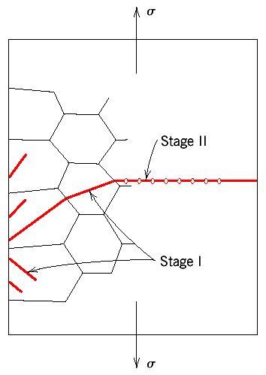
Crack propagation
I: slow propagation along crystal planes with high resolved shear stress. Involves just a few grains. Flat fracture surface
II: faster propagation perpendicular to the applied stress. Crack grows by repetitive blunting and sharpening process at crack tip. Rough fracture surface.
Crack eventually reaches critical dimension and propagates very rapidly

Slide 36
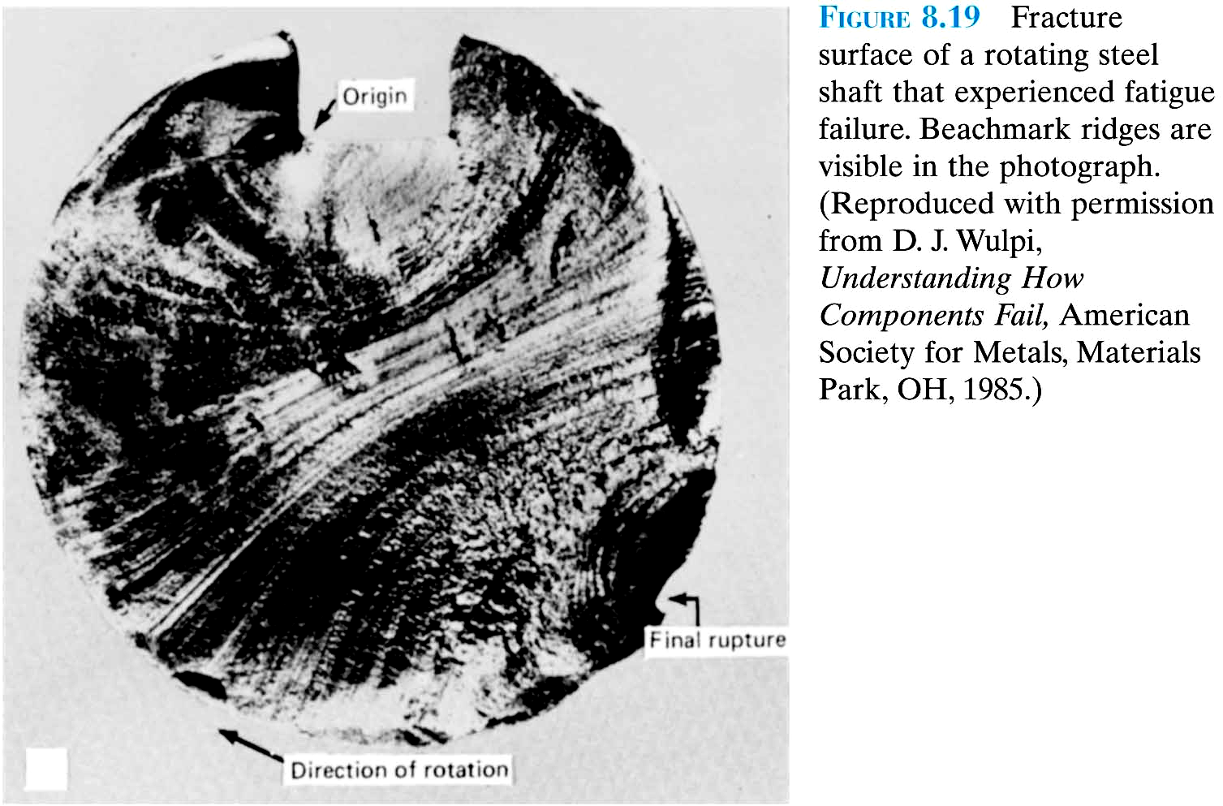
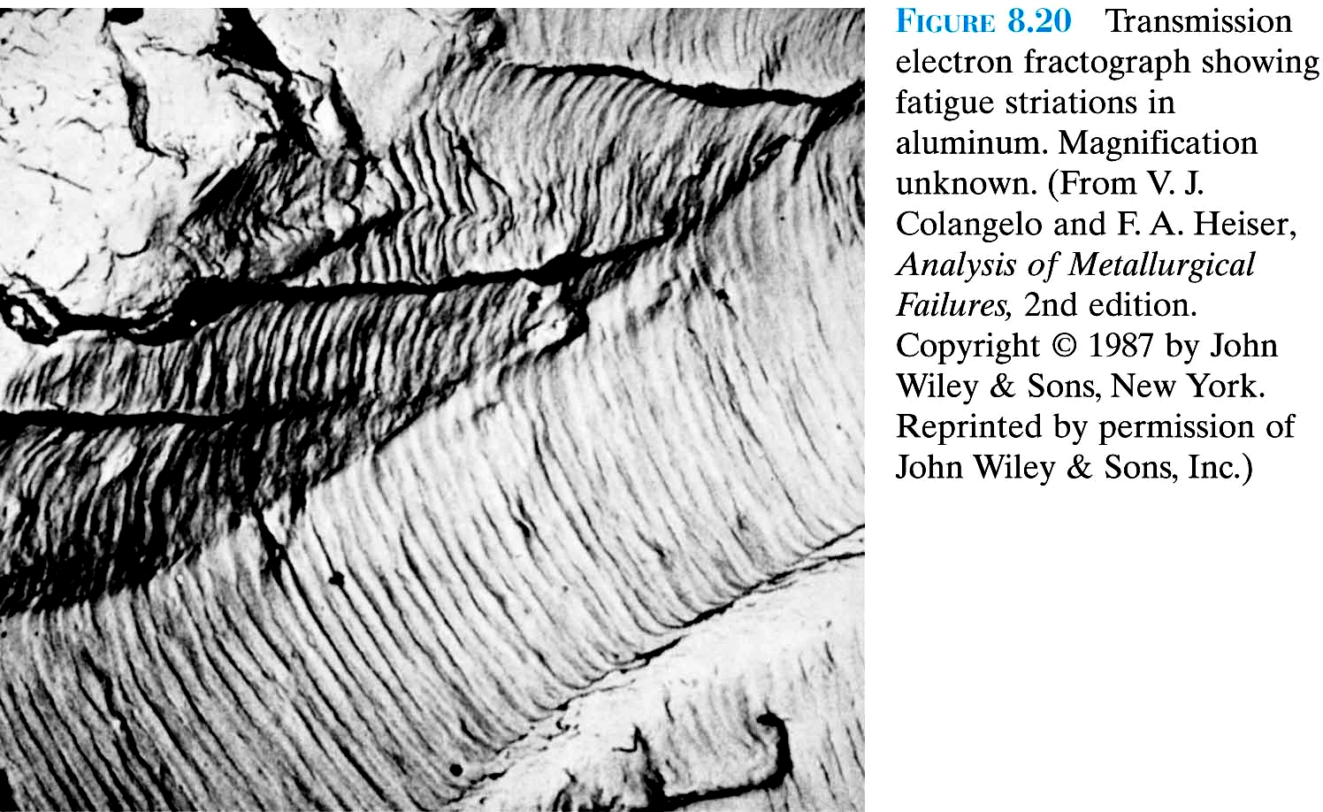

Slide 37
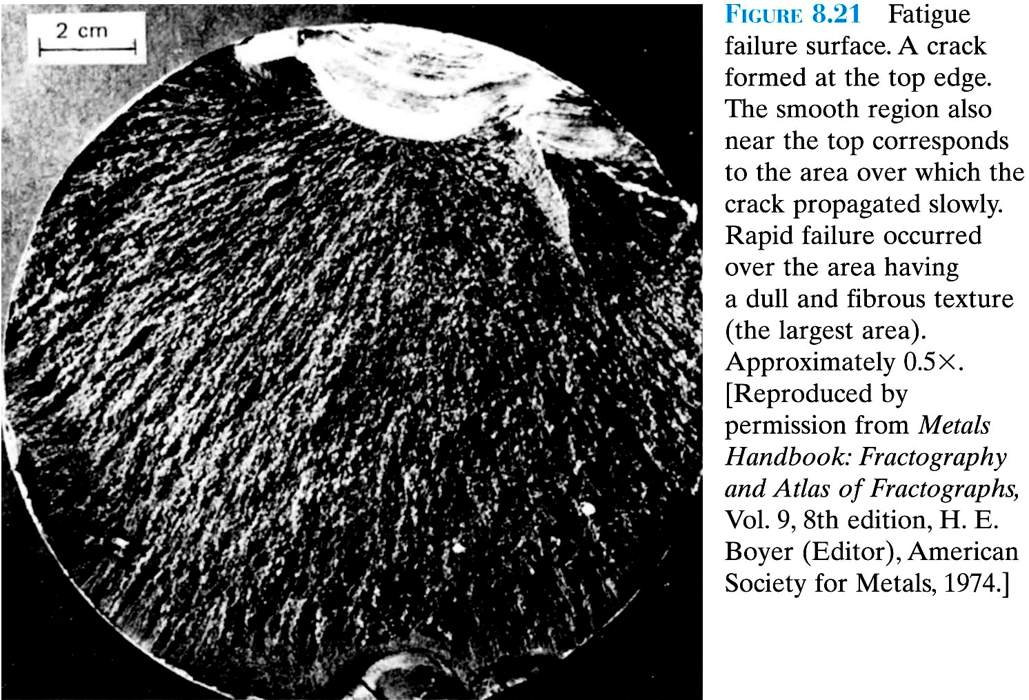

Slide 38
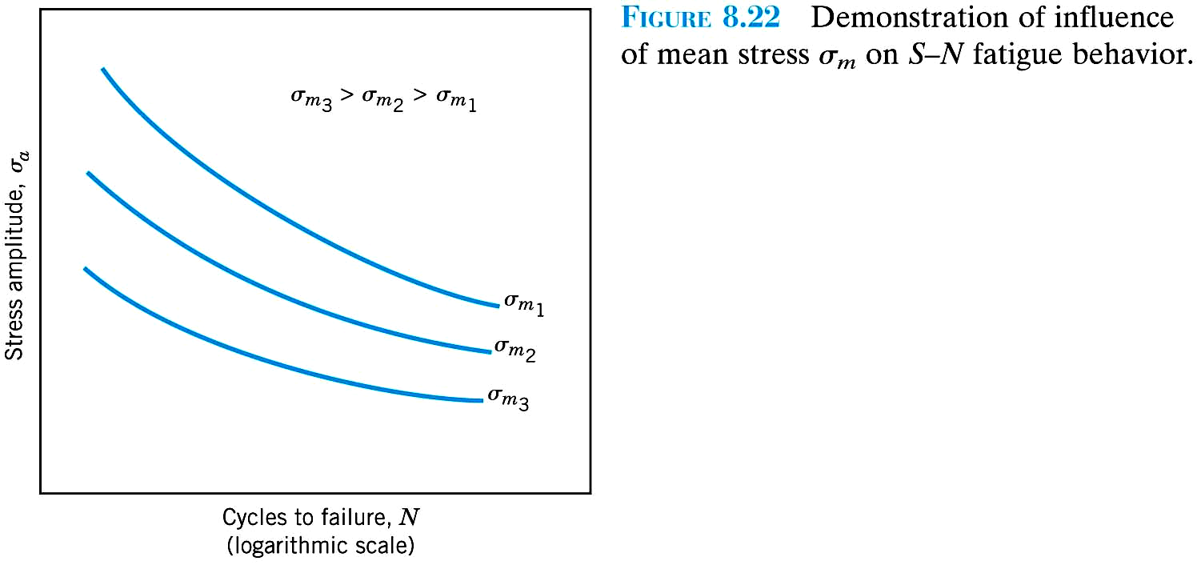

Slide 39
Factors that affect fatigue life
Magnitude of stress (mean, amplitude...)
Quality of the surface (scratches, sharp transitions and edges).
Solutions:
Polishing (removes machining flaws etc.)
Introduce compressive stresses (compensate for applied tensile stresses) into surface layer.
Shot Peening -- fire small shot into surface
High-tech - ion implantation, laser peening.
Case Hardening Steel - create C- or N- rich outer layer by atomic diffusion from surface
Harder outer layer
Introduces compressive stresses
Optimize geometry
Avoid internal corners, notches etc.

Slide 40
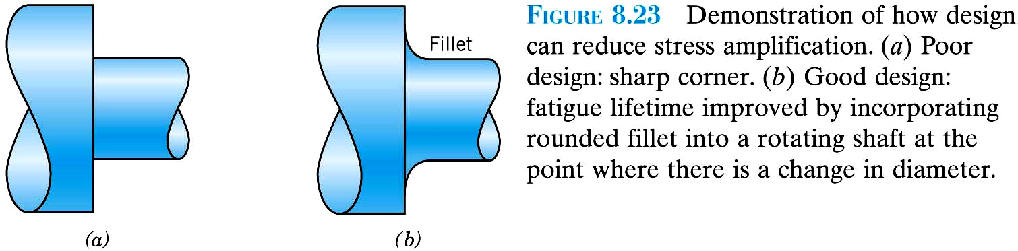

Slide 41
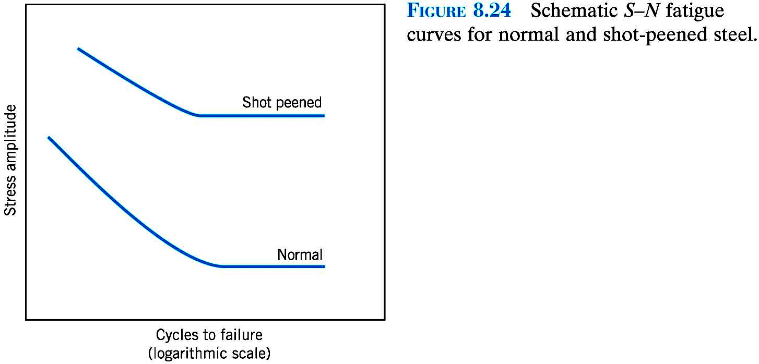

Slide 42
Factors affecting fatigue life
Environmental effects
Thermal Fatigue. Thermal cycling causes expansion and contraction, hence thermal stress.
Solutions:
  eliminate restraint by design
  use materials with low thermal expansion coefficients
Corrosion fatigue. Chemical reactions induce pits which act as stress raisers. Corrosion also enhances crack propagation.
Solutions:
  decrease corrosiveness of medium
  add protective surface coating
  add residual compressive stresses

Slide 43
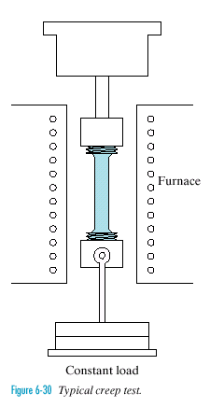
Creep
Time-dependent and permanent
deformation of materials subjected to a constant load at high temperature (> 0.4 T_{m}).
Examples: turbine blades, steam generators.
Furnace
Creep testing

Slide 44
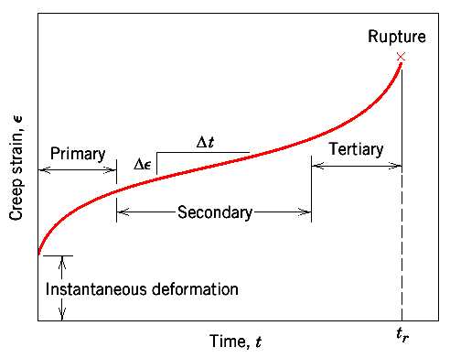
Stages of creep
Instantaneous deformation, mainly elastic.
Primary/transient creep. Slope of strain vs. time decreases with time: work-hardening
Secondary/steady-state creep. Rate of straining constant: work-hardening and recovery.
Tertiary. Rapidly accelerating strain rate up to failure: formation of internal cracks, voids, grain boundary separation, necking, etc.

Slide 45
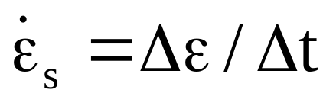
Parameters of creep behavior
Secondary/steady-state creep:
Longest duration
Long-life applications
Time to rupture ( rupture lifetime, t_{r}):
Important for short-life creep
Δε/Δt
t_{r}

Slide 46
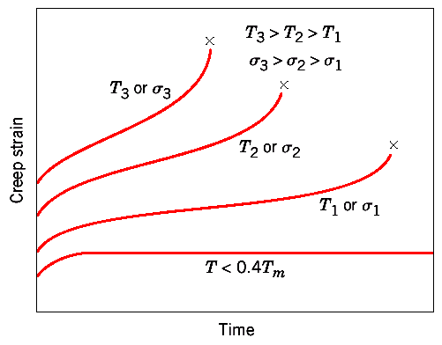
Creep: stress and temperature effects
With increasing stress or temperature:
The instantaneous strain increases
The steady-state creep rate increases
The time to rupture decreases

Slide 47
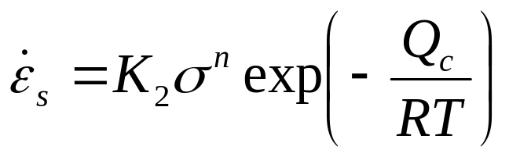
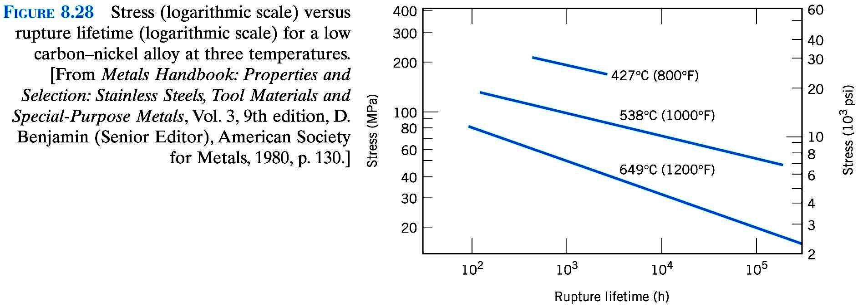
Creep: stress and temperature effects
Stress/temperature dependence of the steady-state creep rate can be described by
Q_{c} = activation energy for creep
K₂ and n are material constants

Slide 48
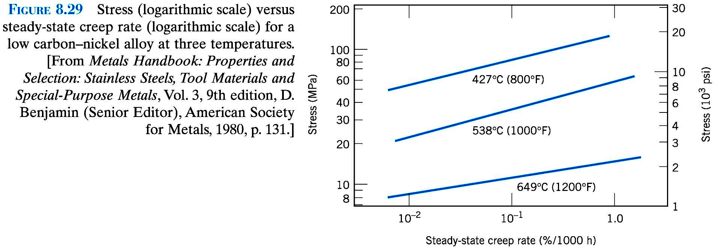

Slide 49
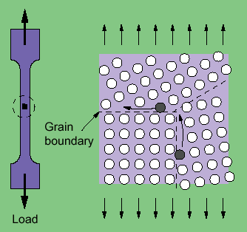
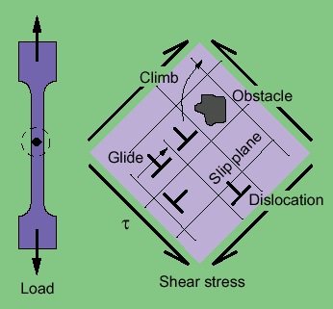
Mechanisms of Creep
Different mechanisms act in different materials and under different loading and temperature conditions:
Stress-assisted vacancy diffusion
Grain boundary diffusion
Grain boundary sliding
Dislocation motion
Different mechanisms → different n, Q_{c}.
Grain boundary diffusion Dislocation glide and climb

Slide 50
Alloys for High-Temperatures
(turbines in jet engines, hypersonic airplanes, nuclear reactors, etc.)
Creep minimized in materials with
  High melting temperature
  High elastic modulus
  Large grain sizes
  (inhibits grain boundary sliding)
Following materials are especially resilient to creep:
  Stainless steels
  Refractory metals (containing elements of high melting point, like Nb, Mo, W, Ta)
  “Superalloys” (Co, Ni based: solid solution hardening and secondary phases)

Slide 51
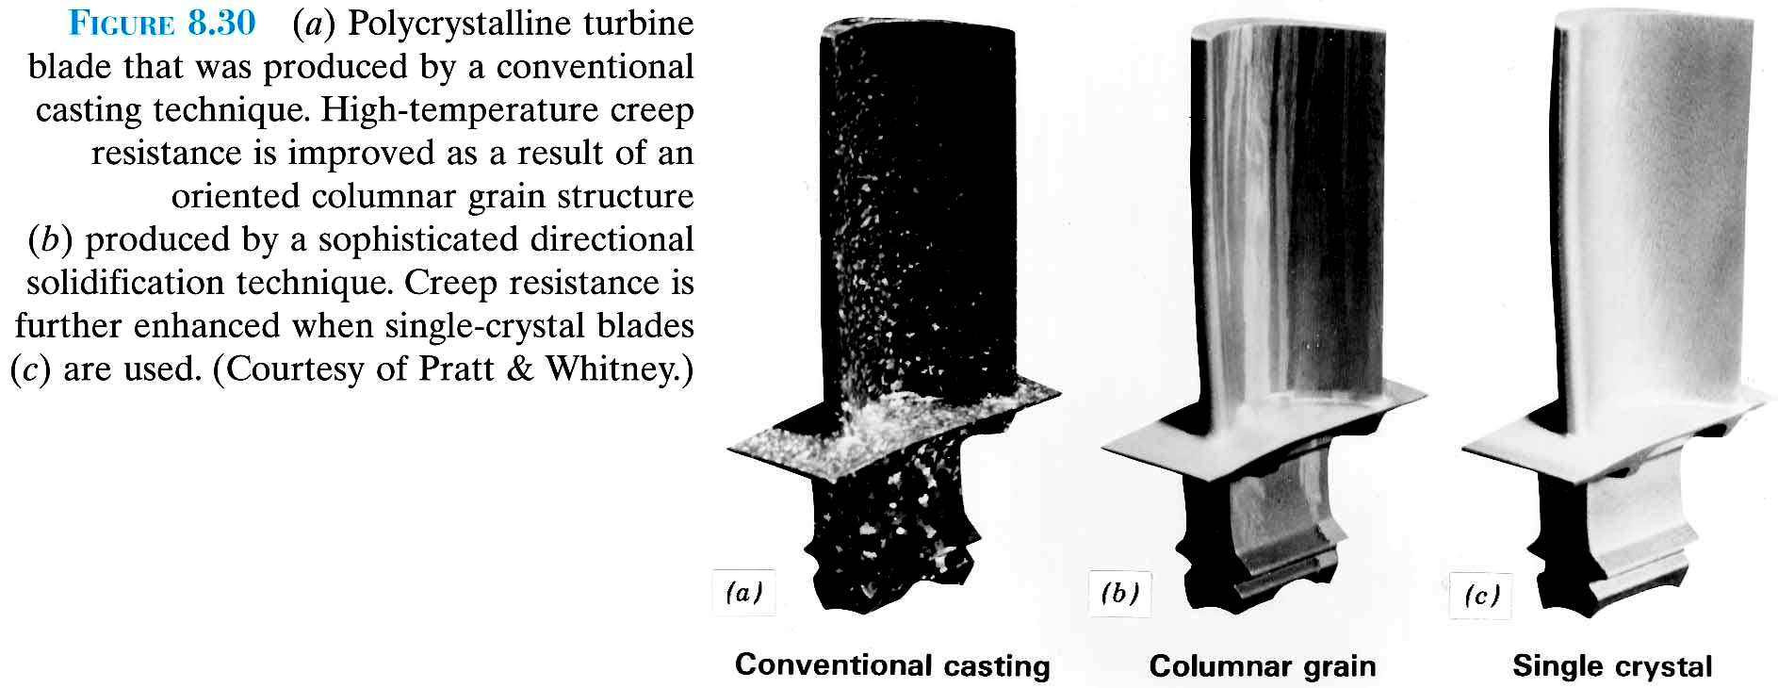

Slide 52
8.6
Some aircraft component is fabricated from an aluminum alloy that has a plane strain fracture toughness of 40MPam^{1/2}. It has been determined that fracture results at a stress of 300MPa when the maximum (or critical) internal crack length is 4.0 mm. For this same component and alloy, will fracture occur at a stress level of 260 MPa when the maximum internal crack length is 6.0 mm ? Why or why not ?

Slide 53
8.23
Cite five factors that may lead to scatter in fatigue life data.

Slide 54
8.25
List four measures that may be taken to increase the resistance to fatigue of a metal alloy.

Slide 55
8.34
Steady-state creep rate data are given here for some alloy taken at 200˚C:
έ (h⁻¹) σ[MPa]
2.5x10⁻3 55
2.4x10⁻² 69
If it is known that the activation energy for creep is 140000J/mol, compute the steady-state creep rate at a temperature of 250 ˚C and a stress level of 48 MPa.

Slide 56
8.36
Cite three metallurgical/processing techniques that are employed to enhance the creep resistance of metal alloys.

